Slide 1
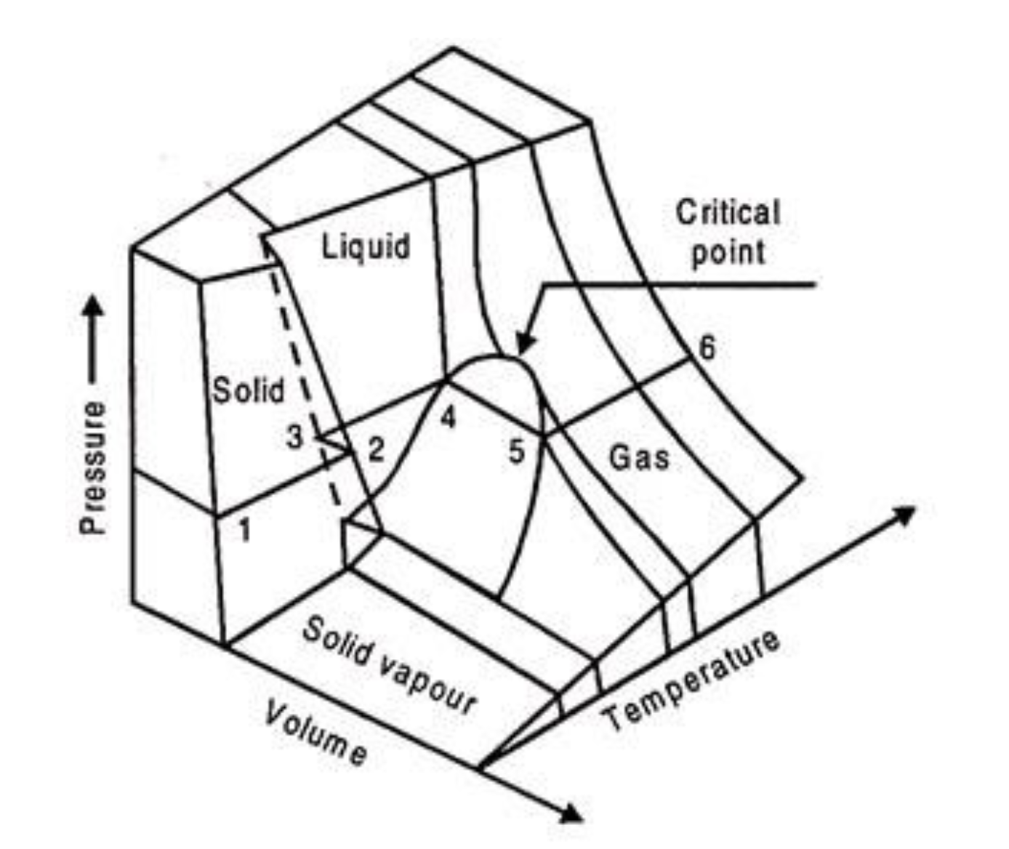
What all gases/liquids/solids do
The Principle of Corresponding States says all substances do this, just at different temperatures and volumes
https://www.engineeringenotes.com/thermal-engineering/real-gases/real-gases-properties-van-der-waals-equation-and-equation-of-state-thermal-engineering/49112

Slide 2
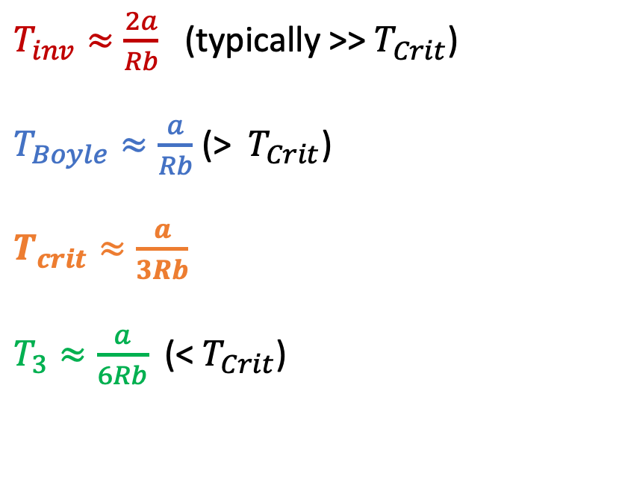
Relationships between these temperatures
$T_{inv}≈\frac{2a}{Rb}$ (typically >>${ T}_{Crit}$)
$T_{Boyle}≈\frac{a}{Rb}$ (> ${ T}_{Crit}$)
$T_{crit}≈\frac{a}{3Rb}$
$T_{3}≈\frac{a}{6Rb}$ (< $T_{Crit}$)
https://www.engineeringenotes.com/thermal-engineering/real-gases/real-gases-properties-van-der-waals-equation-and-equation-of-state-thermal-engineering/49112

Slide 3
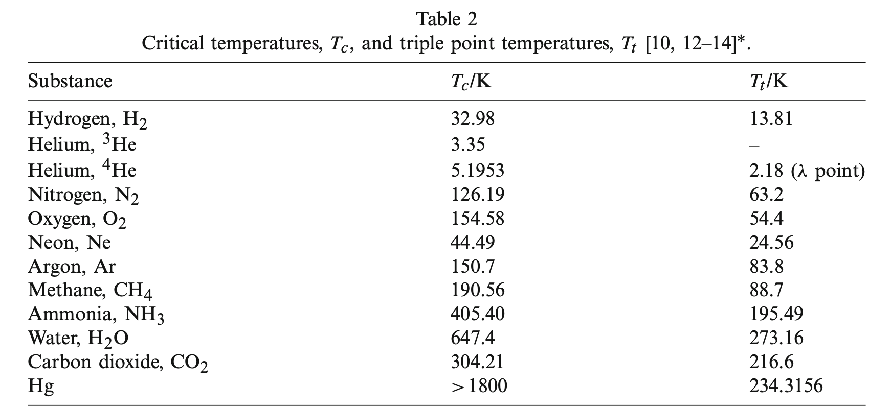

$$T_{3}/K$$
From Berberberan-Santos et al, 2008

Slide 4
Enthalpy, H
By definition, H=U+PV, so it’s an energy; numerically larger than U since PV>0
An extensive function (since U is extensive)
Usually we like to visualize H in T-P state space, so H=H(T,P)
H is “about” heat, as we’ll see

Slide 5
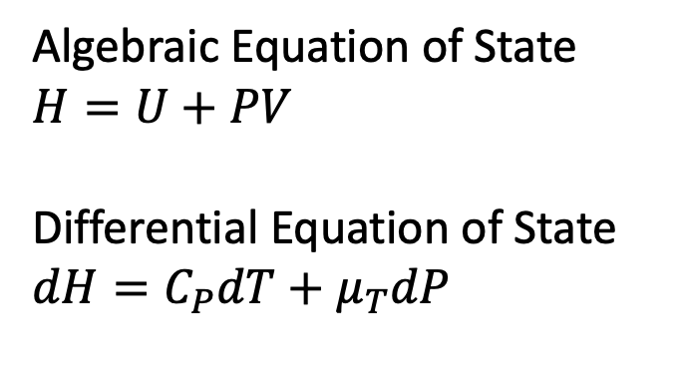

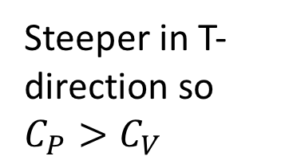
We like to think about enthalpy in a T,P state space
Algebraic Equation of State
$U$ = internal energy
Differential Equation of State
$$dU=C_{V}dT+π_{T}dV$$
Algebraic Equation of State
$$H=U+PV$$
Differential Equation of State
$$dH=C_{P}dT+μ_{T}dP$$
U(T,V)
H(T,P)
Steeper in T-direction so $C_{P}>C_{V}$
V
P
T
T
T-V state space
T-P state space

Slide 6
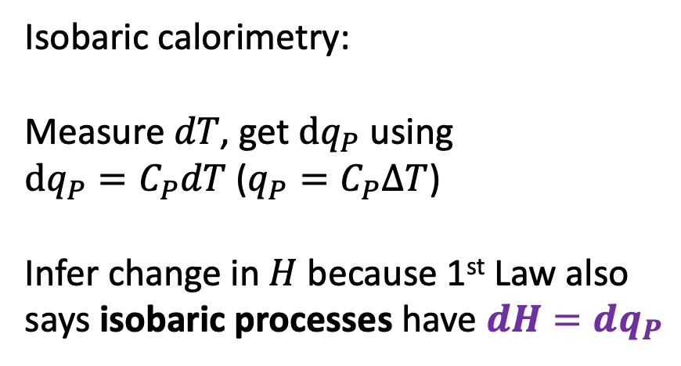
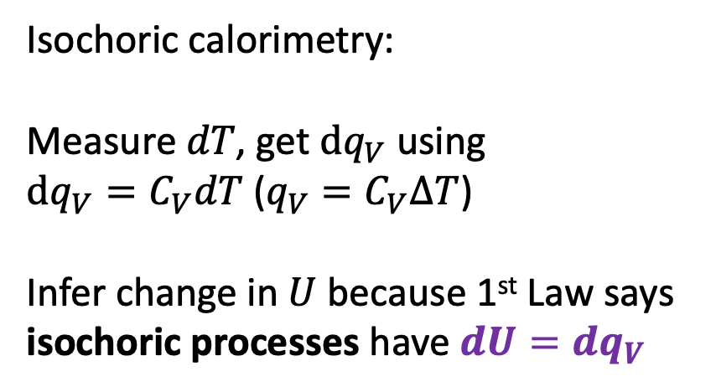
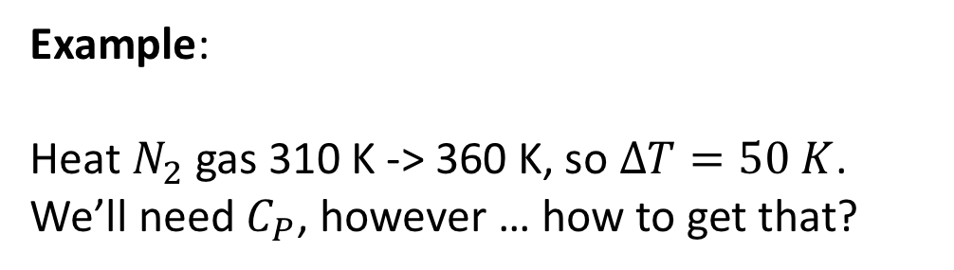
Enthalpy and calorimetry
Isochoric calorimetry:
Measure $dT$, get $dq_{V}$ using
$dq_{V}=C_{V}dT$ (${q_{V}=C}_{V}∆T$)
Infer change in $U$ because 1st Law says isochoric processes have $dU=dq_{V}$
Isobaric calorimetry:
Measure $dT$, get $dq_{P}$ using
$dq_{P}=C_{P}dT$ (${q_{P}=C}_{P}∆T$)
Infer change in $H$ because 1st Law also says isobaric processes have $dH=dq_{P}$
Example:
Heat $N_{2}$ gas 310 K -> 360 K, so $∆T=50 K$. We’ll need $C_{P}$, however … how to get that?

Slide 7

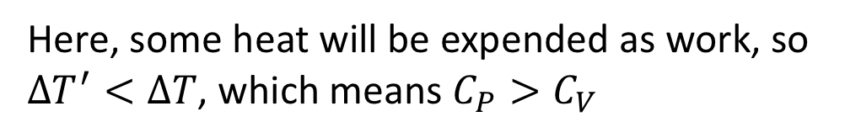
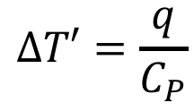
Relating $C_{P}$ to $C_{V}$ … Physical idea: $C_{P}>C_{V}$ … why?
w
q
$$∆T=\frac{q}{C_{V}}$$
q
$$∆T′=\frac{q}{C_{P}}$$
Here, some heat will be expended as work, so $∆T^{′}<∆T$, which means $C_{P}>C_{V}$

Slide 8
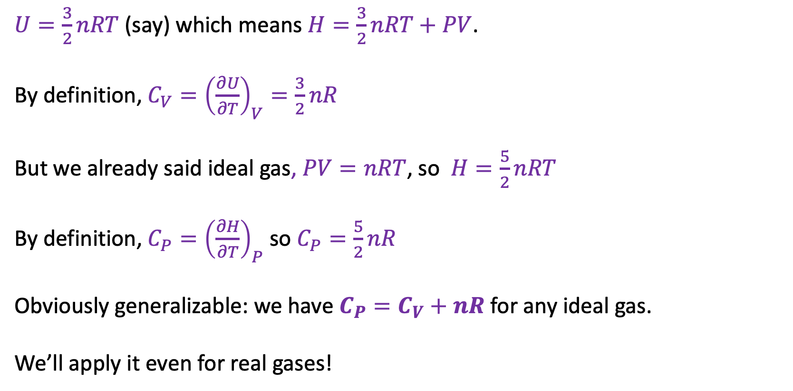
Relating $C_{P}$ to $C_{V}$ … Mathematical idea: let’s derive $C_{P}$ from $C_{V}$ … how? Assume an ideal gas …
$U=\frac{3}{2}nRT$ (say) which means $H=\frac{3}{2}nRT+PV$.
By definition, ${C_{V}=\left(\frac{∂U}{∂T}\right)}_{V}=\frac{3}{2}nR$
But we already said ideal gas, $PV=nRT$, so $H=\frac{5}{2}nRT$
By definition, ${C_{P}=\left(\frac{∂H}{∂T}\right)}_{P}$ so $C_{P}=\frac{5}{2}nR$
Obviously generalizable: we have $C_{P}=C_{V}+nR$ for any ideal gas.
We’ll apply it even for real gases!

Slide 9
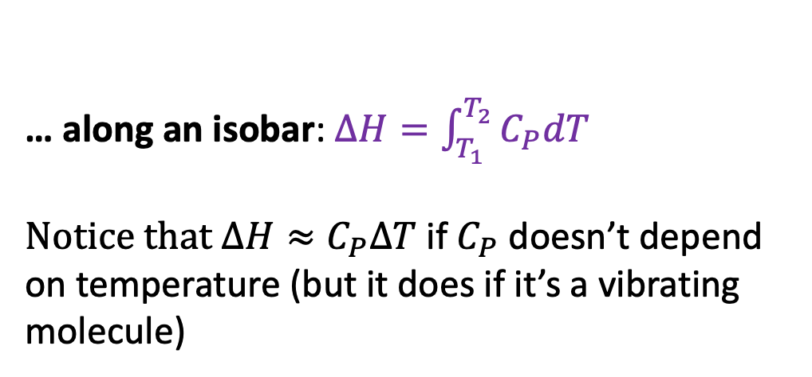

Finding changes in enthalpy when cruising through P,T space …
… along an isobar: $∆H=\int_{T_{1}}^{T_{2}}{C_{P}dT}$
Notice that $∆H≈C_{P}∆T$ if $C_{P}$ doesn’t depend on temperature (but it does if it’s a vibrating molecule)
H(T,P)
P
T
… along an isotherm:$∆H=\int_{P_{1}}^{P_{2}}{μ_{T}dP}$
Notice that $∆H≈μ_{T}∆P$ if $μ_{T}$ doesn’t depend on pressure (but it usually does)

Slide 10

The twist
Ideal gas: $H=H(T)$, so $μ_{T}=0$
Real gas: $H=H(T,P)$, so: $μ_{T}≠0$
But … there is a pattern!
$μ_{T}<0$ at low temperature, $μ_{T}>0$ at high temperature
In between (the “inversion temperature” $T_{inv}$) we have $μ_{T}=0$
($T_{inv}>>T_{crit}$, so this happens to supercritical gases only)

Slide 11



The twist
Ideal gas: $H=H(T)$, so $μ_{T}=0$
Real gas: $H=H(T,P)$, so: $μ_{T}≠0$
But … there is a pattern!
$μ_{T}<0$ at low temperature, $μ_{T}>0$ at high temperature
In between (the “inversion temperature” $T_{I}$) we have $μ_{T}=0$
($T_{inv}>>T_{crit}$, so this happens to supercritical gases only
$$μ_{T}>0$$
$$μ_{T}<0$$

Slide 12
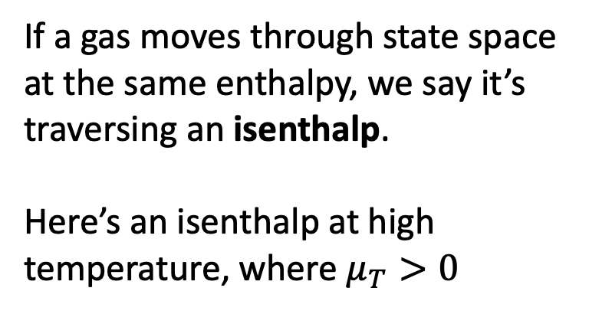
Isenthalps
$$μ_{T}>0$$
If a gas moves through state space at the same enthalpy, we say it’s traversing an isenthalp.
Here’s an isenthalp at high temperature, where $μ_{T}>0$

Slide 13
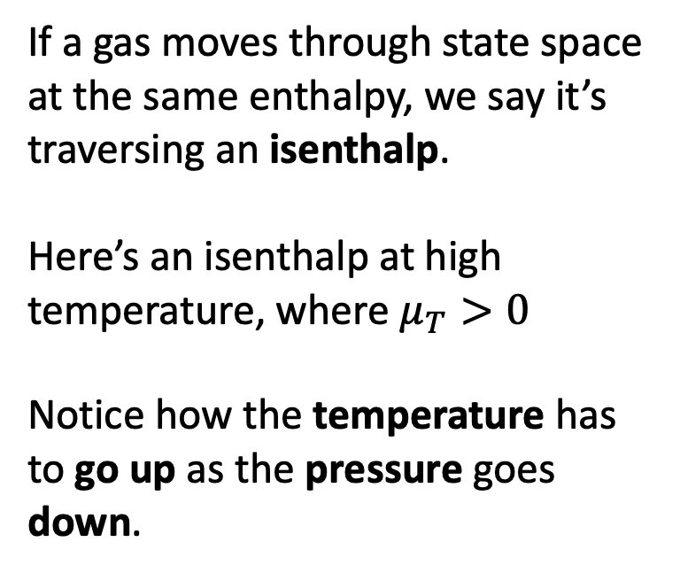
Isenthalps
$$μ_{T}>0$$
If a gas moves through state space at the same enthalpy, we say it’s traversing an isenthalp.
Here’s an isenthalp at high temperature, where $μ_{T}>0$
Notice how the temperature has to go up as the pressure goes down.

Slide 14
Isenthalps
How about this isenthalp?
Starting out at this (low) temperature, the temperature goes down as the pressure goes down.
$$μ_{T}<0$$

Slide 15
Isenthalps
How about this isenthalp?
Starting out at this (low) temperature, the temperature goes down as the pressure goes down.
$$μ_{T}<0$$

Slide 16
Isenthalps
$$μ_{T}>0$$
How about this isenthalp?
Starting out at this (low) temperature, the temperature goes down as the pressure goes down.
$$μ_{T}<0$$

Slide 17
Isenthalps
$$μ_{T}>0$$
Formally, the slope of these dashed arrows would be described by …
$$μ_{T}<0$$

Slide 18
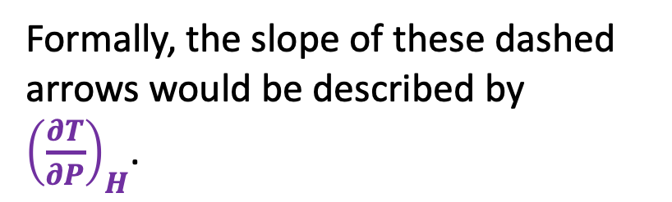
Isenthalps
$$μ_{T}>0$$
Formally, the slope of these dashed arrows would be described by
${\left(\frac{∂T}{∂P}\right)}_{H}$.
$$μ_{T}<0$$

Slide 19
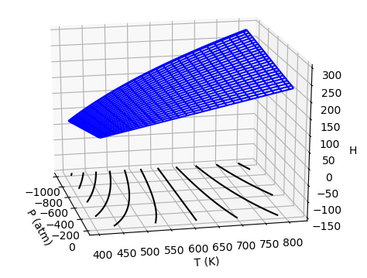


Contours of H(T,P)
Formally, the slope of these lines would be described by ...
$$μ_{T}>0$$
$$μ_{T}<0$$

Slide 20
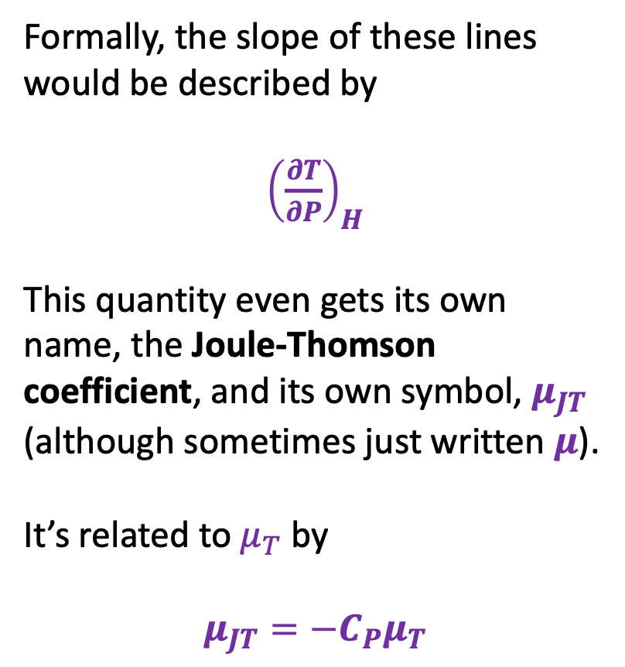
Contours of H(T,P)
Formally, the slope of these lines would be described by
${\left(\frac{∂T}{∂P}\right)}_{H}$
This quantity even gets its own name, the Joule-Thomson coefficient, and its own symbol, $μ_{JT}$ (although sometimes just written $μ$).
It’s related to $μ_{T}$ by
$$μ_{JT}=−C_{P}μ_{T}$$
$$μ_{T}>0$$
$$μ_{T}<0$$

Slide 21

What we learned today …
$T_{inv}$, $T_{Boyle}$, $T_{crit}$, and $T_{3}$
Definition: $H=U+PV$
Differential Equations of State:
$dH=C_{P}dT+μ_{T}dP$ (like $dU=C_{V}dT+π_{T}dV$)
Calorimetry:
$dH=dq_{P}$ and $∆H=q_{P}$ (like $dU=dq_{V}$ and $∆U=q_{V}$)
Heat capacities
$C_{P}=C_{V}+nR$ for ideal gases, $C_{P}≈C_{V}+nR$ for real gases
Inversion temperature:
$μ_{T}$ $<0$ at low T, $<0$ at high T, and $=0$ at the inversion temperature
How to recognize $T_{inv}$ by inspecting $H(T,P)$
U(T,V)
V
T
H(T,P)
P
T

